Slide 1

CS 3020 Final Project Dice Roller
Elijah Boyd

Slide 2
Overview
Allows user to select type of Dice (6-sided, 20-sided, custom)
User can then roll the selected Dice
Results are shown in a table on the right
Statistics are shown below the results
Results and statistics can be saved to a text file

Slide 3
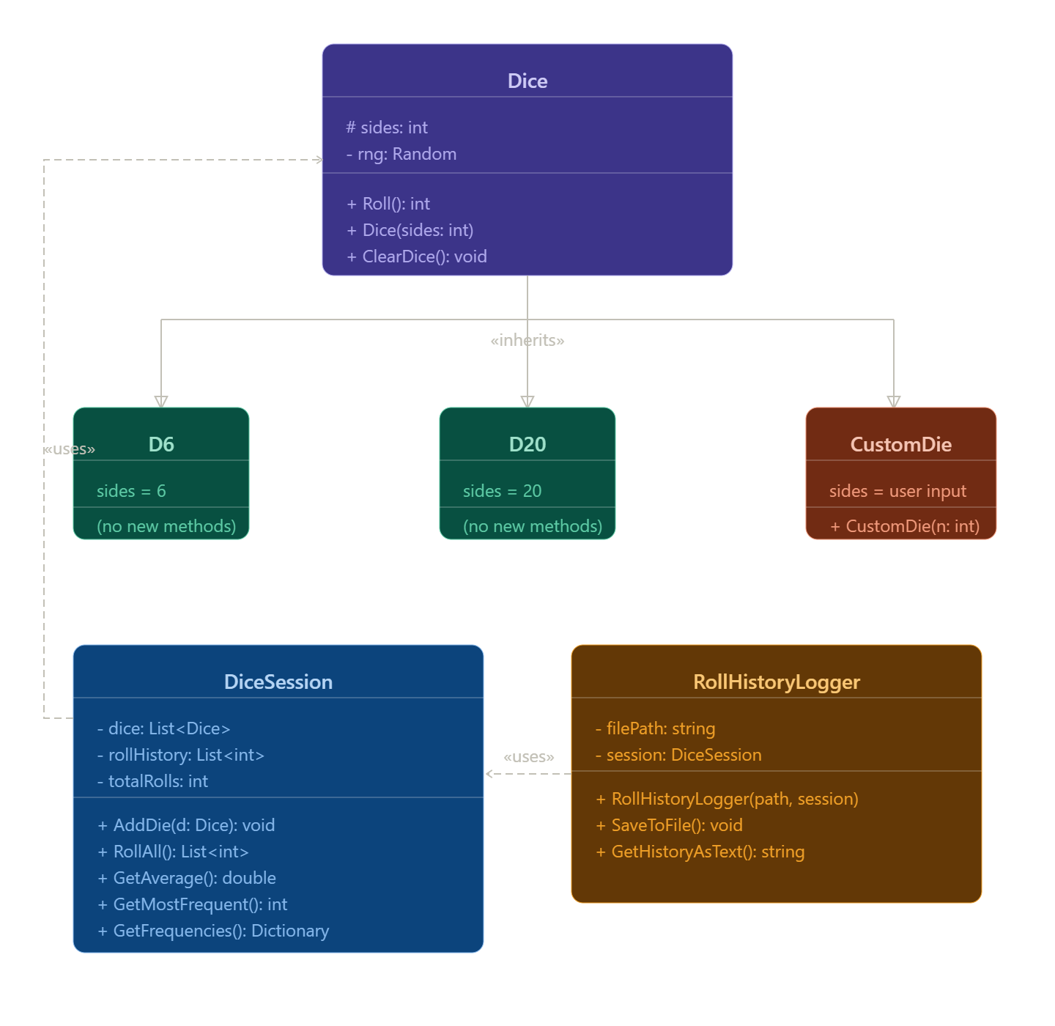
UML Diagram
Utilizes Inheritance, Polymorphism and Encapsulation

